Slide 1

DOSRI AMPLIFYING SOCIALLY RESPONSIBLE INVESTING (SRI) PRESENTATION 5
Team 1: Six Underground
Presented by:
Farhan Pasha Mohammed
Samarth Yadav
Harshal Patil
Kush Shah
Jephthe Louis-Jacques
Naga Sai Kiran Nimmakayala
Instructor:
Professor Henry Wong
Notes:
COMPLETED

Slide 2

AGENDA
1. TEAM MEMBERS ROLES 10. PRODUCT BACKLOG
2. PROBLEM STATEMENT 11. SPRINT BACKLOG
3. PROJECT DESCRIPTION STORIES AND ACCEPTANCE CRITERIA
4. PERSONAS TEST CASES
5. MVP 12. METRICS
6. TECHNOLOGIES 13. RETROSPECTIVE
7. ARCHITECTURE DIAGRAM 14. SPRINT 7 STORIES
8. SPRINT 5 RECAP 15. PROJECT DEMO - GITHUB LINK
9.IMPROVEMENTS
Notes:
COMPLETED

Slide 3


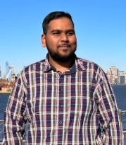

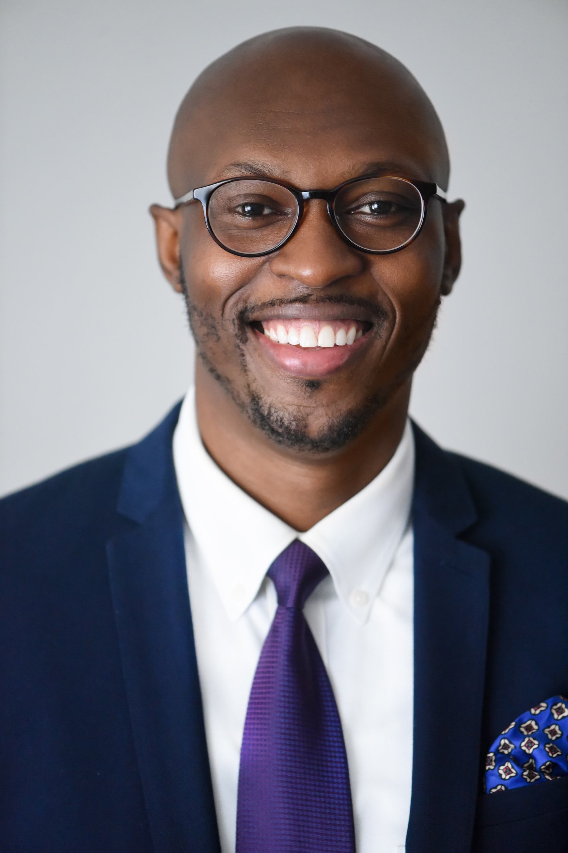

Team Members
Farhan Pasha Mohammed
Naga Sai Kiran Nimmakayala
Jephthe Louis-Jacques
Harshal Patil
Samarth Yadav
Kush Shah
Project Manager
Developer
QA Analyst
Developer
Cloud Engineer
Tester

Slide 4
PROBLEM STATEMENT
Are more investors commit to investing in companies that are socially responsible, these progressive investors struggle to find the metrics that go beyond traditional line items such as traditional performance and expenses. Socially conscious investors struggle to find the metrics that highly business practices that align with their values.
Here is the opportunity we plan to capitalize on, “Dosri” is a free website that provides investors insight about publicly traded companies social rating base on the ‘Environmental, Social, & Governance’ (ESG) standard rating. Dorsi plans on serving this growing community of investors with thorough analysis of company performances that expand beyond traditional financials along with quick access to investing in these Socially Responsible companies.
Notes:
COMPLETED

Slide 5
PROJECT DESCRIPTION
WHAT IS DOSRI?
“Dosri” is a free website that provides investors insight about publicly traded companies social rating base on the ‘Environmental, Social, & Governance’ (ESG) standard rating.
Provides investors with latest stock price, stock price and third-party brokerages accounts for creating investment accounts if interested in buying the stock
The differentiator with the site is to amplify Socially responsible investing amongst investors by quickly helping them identify companies that are sustainable, particularly in in the three categories below:
Environmental - Issues such as climate change and pollution
Social - Issues around workplace practices and human capital
Governance - Issues such as executive pay, accounting, and ethics
Socially Responsible Investing (SRI)
Notes:
COMPLETED

Slide 6
PERSONAS

Slide 7
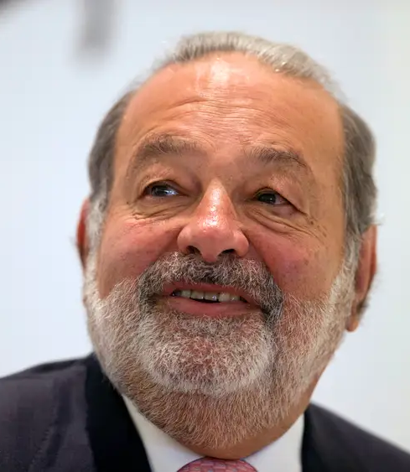
PERSONA 1: CARLOS, PUBLIC SPEAKER
Background Profile:
Carlos, a 60 years old, wealthy long-term investors that does financial public speaking, runs his own family office, always looking for new tools to make better investment decisions
Carlos likes to research companies and read the latest stories about them to quickly identify their long-term financial positions
How Dosri can help?
Carlos can search various publicly traded companies on Dosri and review their financials.
Dosri simultaneously provides google articles related to the searched company for additional insight on performance.
Carlos can search companies on Dosri to gather metrics to better inform his audience of the top performing ESG companies.

Slide 8

PERSONA 2: DONNA, RECENT GRADUATE
Background Profile:
Donna, a 24 years old, recent college graduate that major in product design, currently making 120K USD, identifies as a vegan and cares about the environment.
She sees the value of investing her dispensable money, but she is new to the finance and conscious of companies that are known for conducting unethical practices.
How Dosri can help?
Donna can search various publicly traded companies on Dosri and review their financials.
Dosri simultaneously provides google articles related to the searched company for additional insight on performance.
If Donna is ready to make an investment, Dosri provides quick access links to investment brokerages at real time.

Slide 9
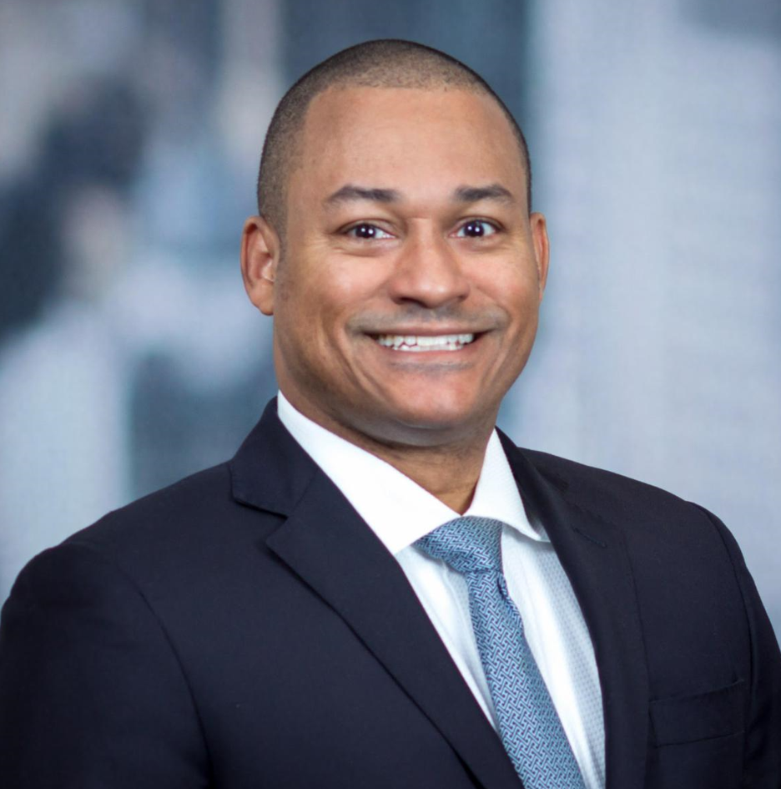
PERSONA 3: PAUL, INVESTOR
Background Profile:
Paul, 26 years old, a recent college graduate working as an investment advisor at a Bank, is aiming to bring more value himself to the Bank and all the customers.
His thinking is not only are investments in socially responsible assets vastly growing. The market shows that this interest stems to a significant extent from investors trying to align their investments with their social preferences.
How Dosri can help?
Dosri helps Paul as he can review SRI companies with a sustainable business plan and can get more accurate information for investment.
Dosri helps provide insights into the company’s financial growth with user friendly UI.
As Paul is completes his review process; Dosri provides quick links to investment brokerages in real-time.
Notes:
In other words, these investors really want to invest in SRI because of its social impact.

Slide 10
MVP
Users can now log in, the feature has been made optional, and guests can still use this website without doing so.
In the fully optimized search box, the user can input the name of the company.
The "Invest in the Company" button will redirect users to third-party investment page.
The user interface of DOSRI has been improved graphically and interactively.
Graphs displayed can also be downloaded into PNG format and other features include zoom-in and zoom-out
The stock price displayed on Dosri website and other websites is exactly correct.

Slide 11



NEW TECHNOLOGIES:
HTML/CSS – Sprint 5
CSS stands for Cascading Style Sheets. CSS describes how HTML elements are to be displayed on screen, paper, or in other media. CSS saves a lot of work. It can control the layout of multiple web pages all at once. External stylesheets are stored in CSS files.
AWS - TBD
Amazon Web Services, Inc. is a subsidiary of Amazon that provides on-demand cloud computing platforms and APIs to individuals, companies, and governments, on a metered pay-as-you-go basis.
AWS - Sprint 6
MySQL is an open-source relational database management system. The "SQL" is the abbreviation for Structured Query Language.
We needed this for our database to capture login and password logs

Slide 12
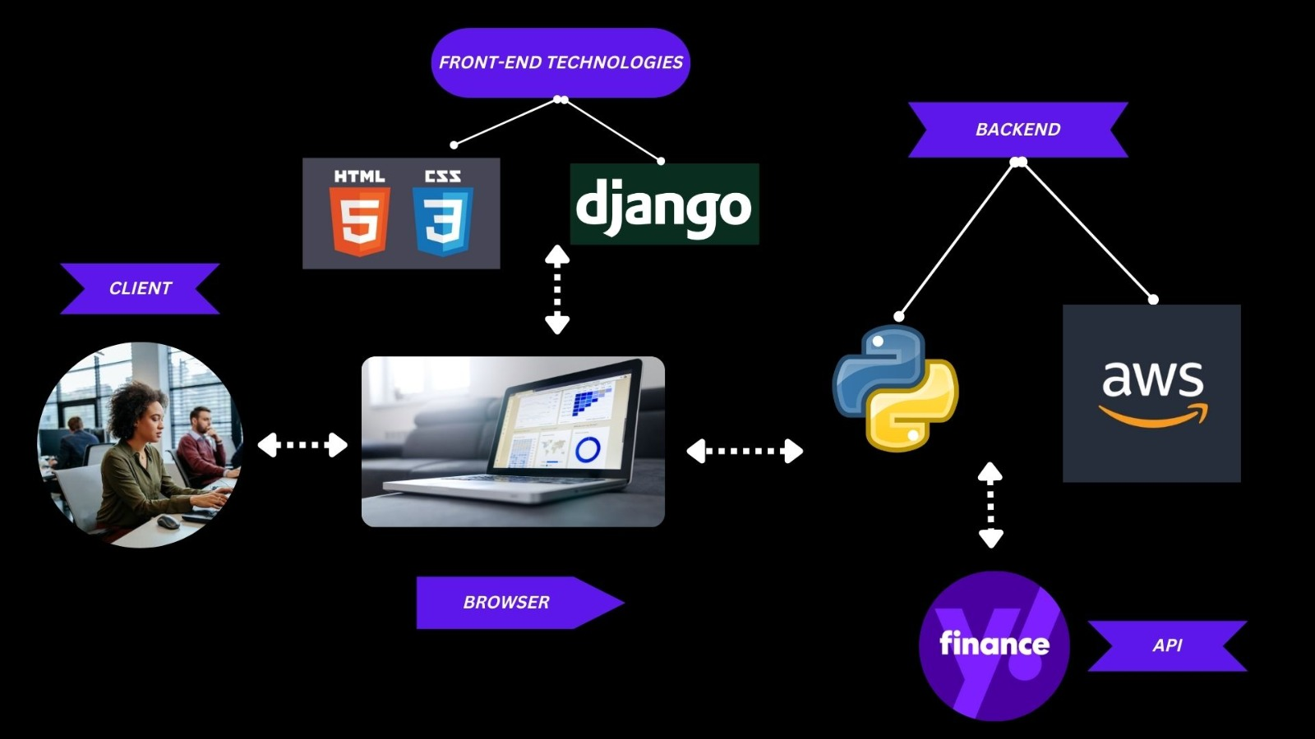

ARCHITECTURE

Slide 13
SPRINT 5 RECAP
In Sprint 5, we updated personas based on feedback from professors.
We reviewed and updated the front end of our website's spring'22 UI as needed.
project plan updated for fall of 22
Our team velocity for Sprint 5 was 69.8%

Slide 14
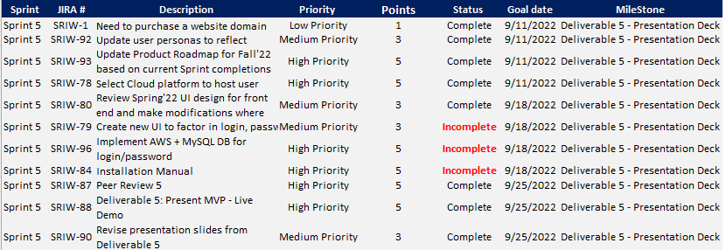
SPRINT 5 RECAP

Slide 15
SPRINT 5 VS SPRINT 6
SPRINT 5
Improved front end UI with CSS/HTML (Continuous)
Researched backend for implementing new feature that requires RDS (i.e.,AWS)
Implemented data metrics in dynamic visualization tools (Graphs)
SPRINT 6
User login feature has been implemented
Invest in this company button will redirect user to third party where user can now invest into stocks
PNG-formatted graphs can be downloaded to give users access to more stock insights.
The sequence of historical data in tabular form has been changed so that users can view the most recent data first and then older data.

Slide 16
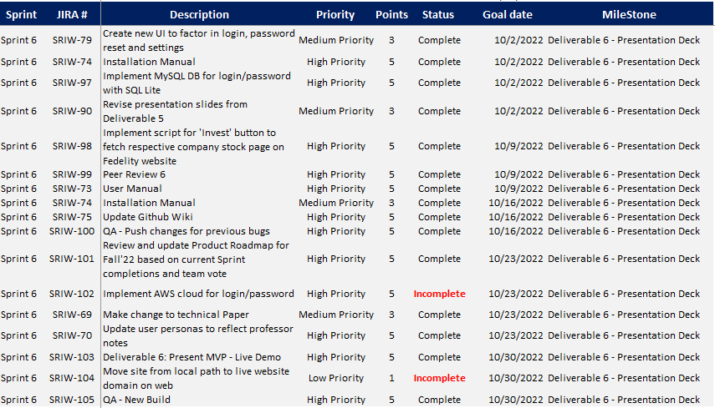
SPRINT 6
Notes:
talk about these incomplete things - why these are incomplete farhan

Slide 17
IMPROVEMENTS MADE FROM PROFESSOR FEEDBACK
Percentages for committed vs completed matrix.
Updated the graph with the percentages
Problem statement was missing
Added a problem statement
Slide titles should be updated in accordance with the checklist requirements.
Updated according to the checklist
Velocity is for current sprint stories And combined is the average velocity for the product
Updated the formula for calculating the velocity
For user story and criteria need to made with the formate professor suggested.
Updated accordingly
Improvements on retrospective adding votes
Updated the retrospectives formate and added vote metrix
Screenshots for user stories from Jira shouldn't be added.
No screenshots of jira have been added.

Slide 18
PRODUCT BACKLOG
Type | JIRA # | Description | Priority | Points | Status | Sprint
API | SRIW-15 | Add Google articles API | High Priority | 5 | Progress.. | Sprint 6
Feature | SRIW-106 | Link button for 'invest now' to 3rd party brokerage website | High Priority | 5 | Completed | Sprint 6
Feature | SRIW-107 | Create user Login and password and settings page UI/UX and workflow | High Priority | 5 | Completed | Sprint 6
Backend | SRIW-108 | Implement RDS, Lambda and AWS dev environment to support creating user login/passwords | High Priority | 5 | Progress.. | Sprint 7
Feature | SRIW-109 | Allow user to compare two companies financial position | High Priority | 5 | Progress.. | Sprint 7
Backend | SRIW-110 | Implement Artificial Intelligence & ML algo | Low Priority | 1 | Progress.. | Sprint 7
Feature | SRIW-111 | Implement new metrics for searched company's financial position | Medium Priority | 3 | Progress.. | Sprint 7

Slide 19
SPRINT BACKLOG
SPRINT | JIRA # | DESCRIPTION | PRIORITY | STATUS | EXPECTED COMPLETION
SPRINT 6 | SRIW-102 | IMPLEMENT AWS FOR LOGIN/ PASSWORD | HIGH PRIORITY | INCOMPLETE | SPRINT 7
SPRINT 6 | SRIW-104 | MOVE SITE FROM LOCAL MACHINE TO LIVE DOMAIN ON WEB | LOW PRIORITY | INCOMPLETE | SPRINT 7
It is a lengthy process to set up an AWS account and going through the documentation for cloud deployment.
Running the code on a local machine allows the developer flexibility while the website is still being developed.
What went wrong ??
Notes:
waiting for code, will look if necessary changes are made, then we can update the backlog in jira and PPT

Slide 20
USER STORY & ACCEPTANCE CRITERIA
User Story:
As a social investor, I'd like to be informed of the ESG score of the firm I'm investing in before buying any stocks.
Acceptance criteria:
Given that the investor is already on the page, he or she will enter the name of the company in the search box and click the submit button, which will then display the company's ESG score.
Notes:
other teams has added some points to it for user stories what is that?

Slide 21
USER STORY & ACCEPTANCE CRITERIA
User Story:
In order to provide my clients with beneficial returns, as an investment advisor, I want to be able to view historical data for the company.
Acceptance criteria:
Given that the user is already on the page, he or she will type the firm name into the search field, which will display the company's historical trend over the last x months.

Slide 22
USER STORY & ACCEPTANCE CRITERIA
User Story:
I want to be able to invest in socially conscious companies as a young, inexperienced investor, and I want to learn as much as I can about the particular firm before I buy any of its stocks.
Acceptance criteria:
Given that the user is already on the website, he or she will type the firm name into the search bar and click Submit. After reading historical data and ESG score, the user can scroll to the bottom of the page and click Invest, which will take them to a third-party payment channel once they are pleased.

Slide 23
SPRINT 6: TEST CASES
TEST CASE ID | SCENARIO | TEST CASES | EXPECTED RESULT | PASS/FAIL | TEST DATA
SRIW-98 | Invest in this company | User wants to invest in a particular company then SRI website will redirect user to the third party website | A third party website should open in new window | Pass | Invest in this company will redirect user to a third party website for investment
SRIW-61 | Graph | User can enter company name in search bar | Graph should be displayed above the chart | Pass | User can see graph of stock price
SRIW-79 | GO | User can click on GO for login and signup | A pop-up should open for login and sign up | Pass | User can see login and signup pop
SRIW-79 | Login | User can click on login button | A login page should popup | Pass | User can enter the datails to login
SRIW-79 | Signup | User can click on signup button | A signup page should popup | Pass | User can enter the datails to signup
SRIW-79 | Enter console | User can click on enter console button | User should be redirected to previous page | Pass | User can see the previous page
SRIW-79 | Login with google | user click on google authentication link | User should be able to login with google | Pass | user can login with google
SRIW-97 | database | Implement MySql for login/password | Credentials of should be stored in DB | Pass | credentials of user are stored in DB
Notes:
heavy focus on the new feature
testing icons for Login and password
all testing was successful

Slide 24
METRICS
TEAM VELOCITY
BURNDOWN CHARTS
COMMITTED/ COMPLETED RATIO

Slide 25
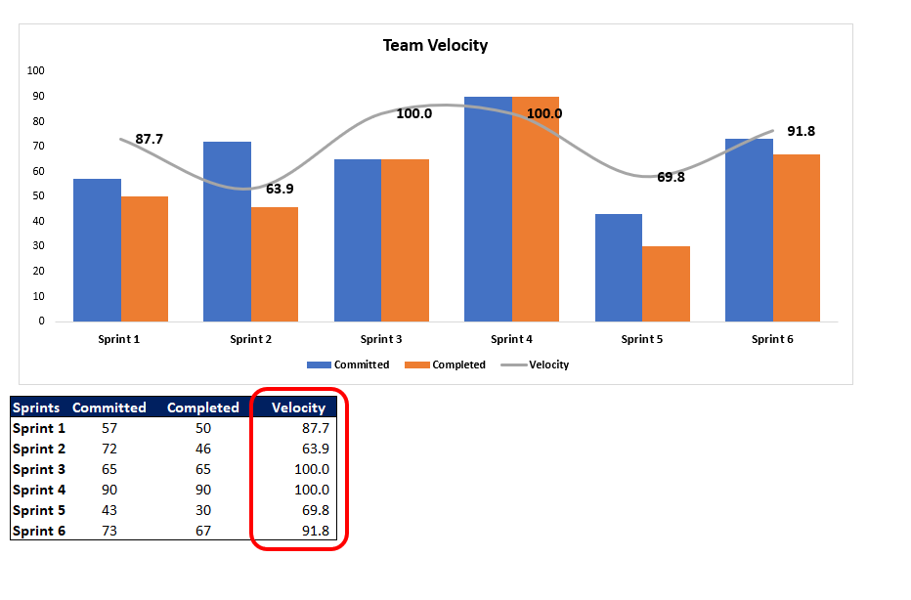
SPRINT 6: TEAM VELOCITY
Notes:
low, medium, high priority
sprint 5

Slide 26
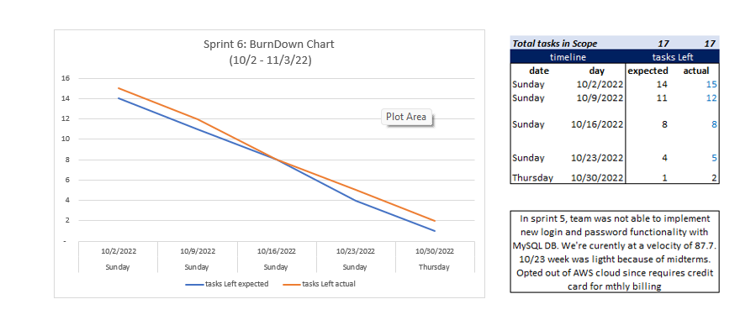
SPRINT 6: BURNDOWN CHART
Notes:
as mentioned by Kush, we have two open items that are now part of sprint 7

Slide 27
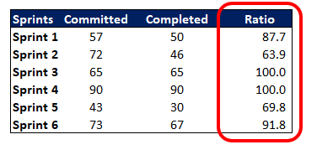
SPRINT 6:
COMMITTED/
COMPLETED RATIO

Slide 28
RETROSPECTIVES

Slide 29
WHAT WENT WELL | WHAT NEEDS IMPROVEMENT | NEXT STEPS | Votes (OUT of 6)
-Participation in great strength at all sprint meetings and team meetings | - More Team interaction and find a common time | -Started sharing the calendar, which assisted in scheduling meetings for discussion | 6
-Team committed to a fixed plan and completed all tasks on time. | - It is essential to increase the work's accuracy. | -Create meetings with team members to improve the accuracy | 5
- Implementation of the Login page was successful | - Approximate allocated time for each task that needs improvement | -Revise the task which needs to be performed can it be a group task or individual | 6

Slide 30
SPRINT 7 future work
Application Logo has to be designed and website has to be deployed on AWS
User interface of application has to be further improved
creating Google articles for the company that is looked for using our software
Integrate google article API to add articles on the page

Slide 31
PROJECT DEMO

Slide 32
GITHUB LINK
https://github.com/CS691/Socially-Responsible-Investing-A-financial-website/wiki

Slide 33
THANK YOU!

